Slide 1

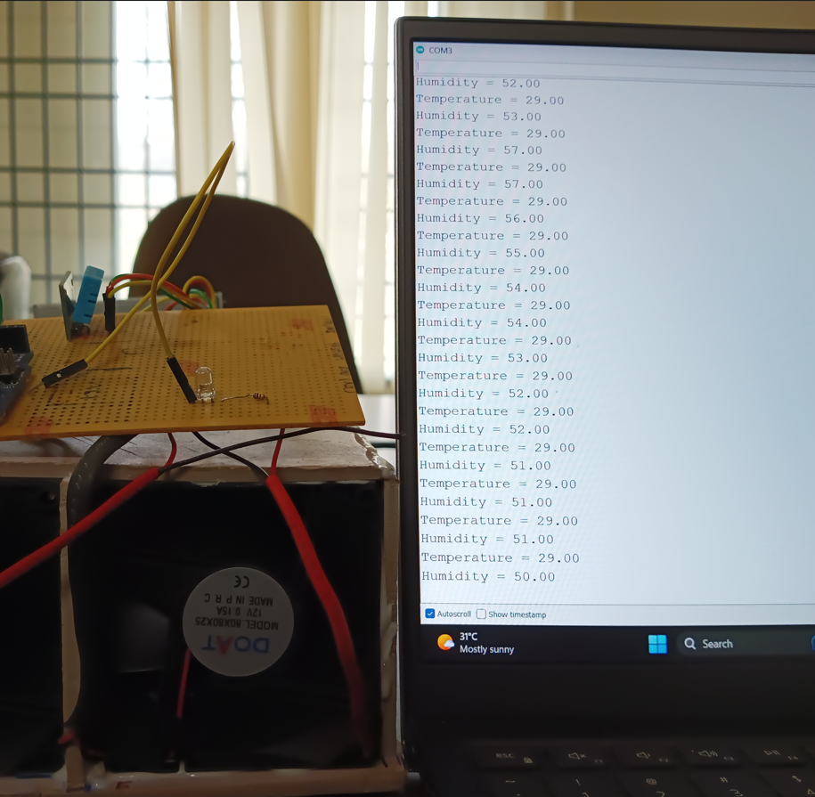
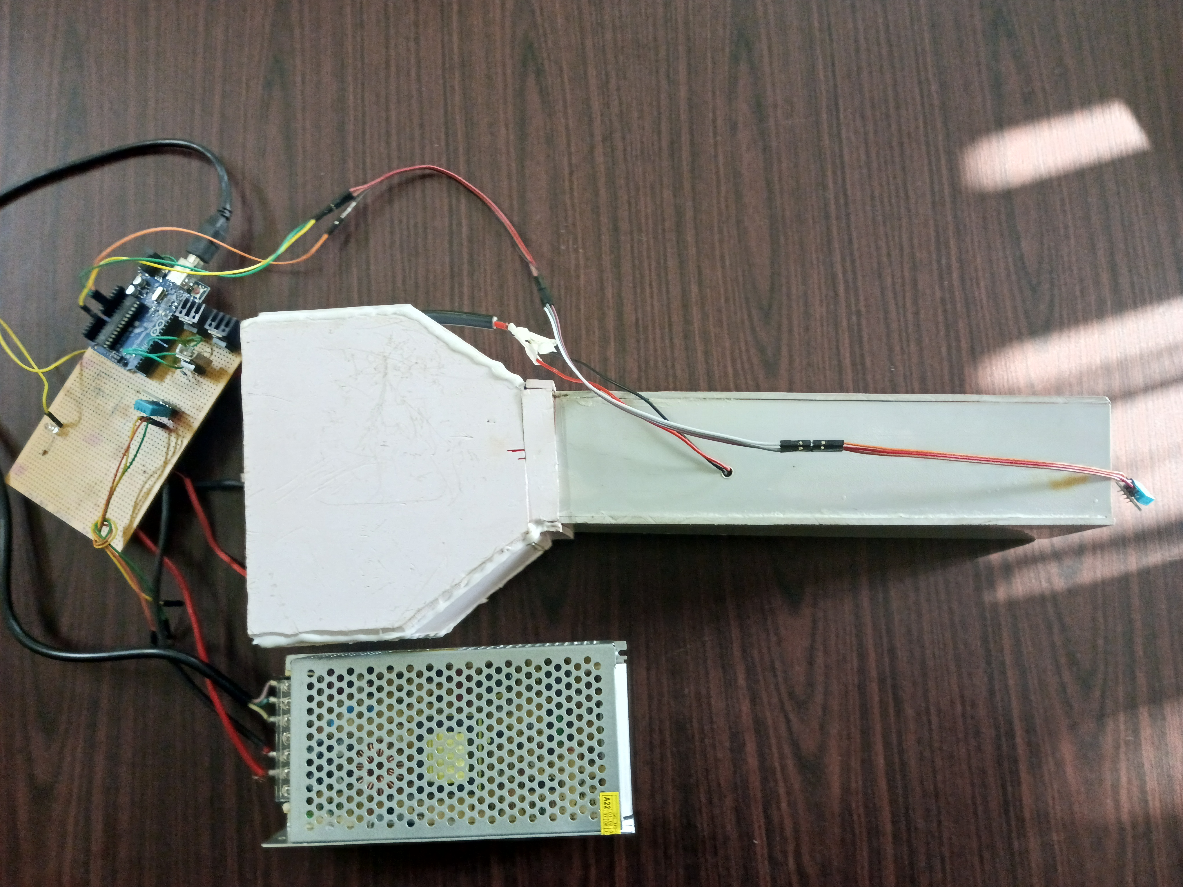
SMART STORAGE BIN
Kavin A S (RA1911004010008) , Rohit Kumar Mohanty (RA1911004010259) , Keerthi Appana (RA1911004010523)
Under the guidance of Associate Prof. Dr. Sounik Kiran Kumar Dash
Department of Electronics and Communication, SRM Institute of Science and Technology, Kattankulathur, Chennai
The Internet of Things (IoT) is an emerging technology and is now completely transforming the ways in which industries operate.
India is the second largest producer of fruits and vegetables in the world after China. Since we can only retain the quality of fruits and vegetables after harvesting, it is crucial to store them in the right ecosystem since the quality of fruits and vegetables has a significant impact on the environment during storage.
The storage box or bin will be designed to protect the food from environmental factors.
Realistic Constraints
Conclusion
Environmental elements including the type of storage structure, temperature, pH, moisture, etc. have a significant impact on the natural contamination of the food grains.
The smart storage bin will benefit all stakeholders involved in vegetables and fruits production and storage, whether directly or indirectly.
Hence using peltier by controlling the temperature and humidity of the environment and using DHT11 sensor we implemented a smart storage bin.
Introduction
It took a few days to get the peltier properly configured with the heat sink and switched power supply (SMPS).
Using an Arduino it is difficult to make Peltier compatible with MOSFET and fan since peltier operates in both hot and cold environments.
Controlling the humidity and temperature using peltier and the DHT11 sensor is a challenging task.
Result
The temperature and humidity of the crate will be detected by DHT11, which is positioned within the crate.
Hot and cold air is blown into the smart storage bin to maintain the desired temperature in accordance with the DHT11's output.
Methodology
References
P. K. Omre, Shikhangi Singh, Shikha Singh, “Waste utilization of fruits and vegetables”, South Asian J. Food Technol. Environ, Vol 4(1),January (2018).
Aritra Das, Chanchal Mondal ,“Studies on the utilization of fruit and vegetable waste for generation of biogas”, International Journal Of Engineering And Science ,Vol.3, Issue 9,PP 24-32, September (2013).
Nicole Kennard ,“Food Waste Management”, Encyclopedia of the UN Sustainable Development Goals Zero Hunger, p. 355-370, January (2019).
Ms. R. Sharmeela, Bava Harini.K, Haritha K, Jeevanya, S.Shiny Devadharshini , “Smart Storage Bin with Real-Time Monitoring and Control of Stored Grains”, International Journal for Research in Applied Science and Engineering Technology, Vol 8, Issue VII, July (2020).
P. Benes , S. Klusacek, and P. Pikal, “In-process measurement of particle size distribution”, November (2004).
Mihai Bogdan, “Temperature and humidity measurement system” , October (2016),
J. Gustavsson, Christel Cederberg, Ulf Sonesson, R. Van Otterdijk, Alexandre Meybeck, “Global food losses, and food waste: Extent, causes, and prevention”, Food and Agriculture Organization, January (2011).
The storage bin is created based on peltier effect. IOT-based technology powers the system's features.
The temperature and humidity of the environment is controlled using DHT11 sensor. It is implemented using arduino hardware.
The Peltier will produce heat and cold on the corresponding sides when the circuit is in the ONN state.
The 12V power supply [SMPS] is used to power MOSFETs.
The 3-MOSFET [IRFZ44-N] drain is controlled by an Arduino Uno.
To dissipate the heat generated by the MOSFET, a heat sink has been installed.
To dissipate the heat generated by the MOSFET, a heat sink has been installed.
When one fan acts as an inflator and the other as a deflator, two fans across from each other are connected in series.
In India, vegetables and fruits have been preserved using conventional techniques since ancient times, however this practice has several drawbacks, including degradation, discoloration and moisture damage.
Waste from farming has dramatically increased. Fruit and vegetable wastes are generated throughout the supply chain and vary greatly based on how they were processed.
Therefore, we propose a smart storage bin to reduce the waste.
Problem Statement
Proposed Structure
The primary goal of this project is reduce the risk of crop destruction due to temperature, humidity, fire, rain and other factors by preserving the fruits and vegetables.
Thus, the farm produce that has been kept can be provided as and when needed.
Objective

